Slide 1
ARTIFICIAL INTELLIGENCE
8 QUEENS PROBLEM
PRESENTED BY:
DHEERAJ CHAUDHARY (17BCS009)
PRIYA A TIRU (17BCS021)
VIVEK RAI (17BCS033)
GIVEN BY : DR. JAYLAKSHMI BANDA

Slide 2
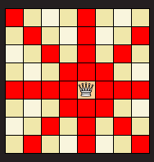
PROBLEM STATEMENT/ HARDNESS
Using a regular chess board, the challenge is to place 8 queens on the board such that no queen is attacking any of the other.

Slide 3






SOLVING N-QUEENS PROBLEM
N < 4
Cannot use N Queens

Slide 4
Search Space: The set of objects among which we search for the solution
Example: N-queen configurations
Goal condition: This is the characteristics of the object we want to find in the search space?
Example: Non-attacking n-queen configuration

Slide 5
SOLUTION USING BACKTRACKING
One of the approach that guarantees a solution, though it can be slow
Can be seen as a form of intelligent depth-first search

Slide 6
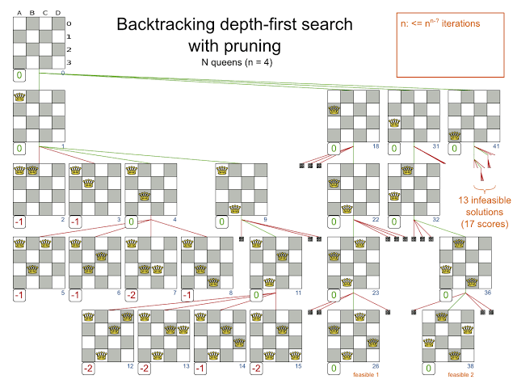

Slide 7
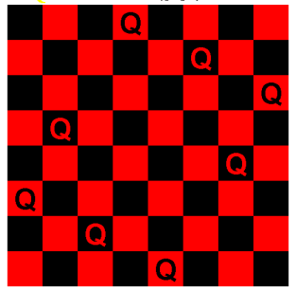

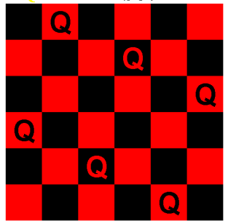

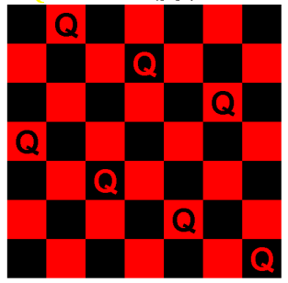

MATHEMATICAL FORMULATION Iterative (non-search)
For N > 4 only
N is even except N ≠ 6K+2 :
Row 1 to N/2: Queen on 2*Row
Row N/2+1 to N: Queen on 2*Row-N-1
N is even, N = 6K+2
Row 1 to N/2: Queen on (2*Row + N/2 - 3)mod N +1
Row N/2+1 to N: Queen on N - (2*(N-Row+1) + N/2 - 3)mod N
N is odd:
When N is even, no queen is placed on position (1,1).
So this just places the first N-1 queens as on an N-1 (even) sized board, then places the last queen on the bottom right position (N,N).

Slide 8
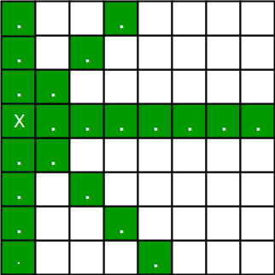
CONSTRAINTS
There can be only one queen in a column , and another constraint prohibits two queens on the same diagonal.
No queens on the same row.
FIG 2

Slide 9
Thank you

